Slide 1
Automated framework with C#
Base principles from scratch

Slide 2
Introduction

Slide 3
Introduction
Visual Studio
Versions Control System (Git) basics
C# basics
HTML/CSS basics
WebDriver
NUnit
Framework creation

Slide 4
Visual Studio

Slide 5
Visual Studio
To download VS Community edition go to official site:
https://visualstudio.microsoft.com/vs/community/
During installation include the following workloads:
ASP.NEN and web development
.NET desktop development
.NET cross-platform development
Having installed check out the local current version of .NET Core in Command Prompt:
dotnet --info
and go to
https://dotnet.microsoft.com/download/dotnet/5.0
to compare with latest stable version.
Update if needed.

Slide 6
Git basics

Slide 7
Git basics
To download Git go to official site:
https://git-scm.com/downloads
To create a repository on GitHub:
Create an account
Create a repository
Clone the repository
List of Bush basic commands:
$ cd </d/directory> - Go to a directory
$ ls – List of the current directory files
$ cd ../ - Back to previous directory in hierarchy
$ clear – Clear window
$ exit – Exit from console
Notes:
Show practical application of bash commands before cloning the repo

Slide 8
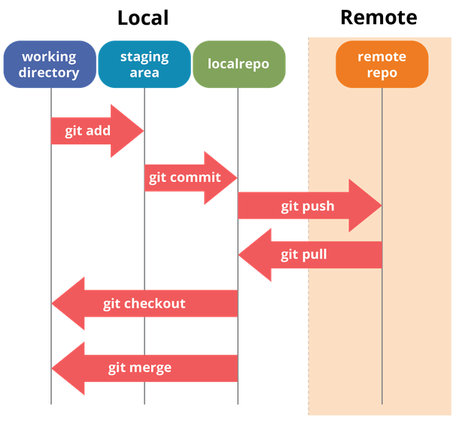
Git basics
List of basic commands for use:
$ git clone <link-to-repository> - Clone remote repository
$ git branch – See all local branches
$ git checkout <branch-name> - Switch to a chosen branch
$ git checkout –b <branch-name> - Create new branch and switch to it
$ git status – Check for changed files
$ git add ––all – Stage all local changes
$ git commit –m ‘Commit message’ – Commit all local stages
$ git push – Push all local commits to remote repository
$ git pull – Pull all remote changes
Notes:
Having cloned the repo create a new branch
Create a console application project and explain about stages in Git.
Explain basic git commands

Slide 9
Git basics (general workflow)
1
Create and clone a repository
6
9
Add changes to stash
$ git add --all
Make Pull request on remote and approve it
2
Check out to local main branch $ git checkout main
7
Commit changes
$ git commit –m ‘Commit message’
3
Pull changes from remote main
$ git pull
Yes
Logic part done
8
Push changes to remote $ git push origin HEAD
4
Create working branch
$ git checkout -b <branch-name>
No
Task done
5
Create or update files on working branch
Yes
No
Notes:
Explain general git workflow
Stage changes
Make first commit
Push created console application

Slide 10
C# basics Primitive Types and Variables

Slide 11
C# basics Primitive types
Data Types | Default value | Minimum Value | Maximum Value
short | 0 | -32768 | 32768
ushort | 0 | 0 | 65535
int | 0 | -2147483648 | 2147483647
uint | 0u | 0 | 4294967295
long | 0L | -9223372036854775808 | 9223372036854775807
ulong | 0u | 0 | 18446744073709551615
float | 0.0f | ±1.5×10⁻⁴⁵ | ±3.4×10³⁸
double | 0.0d | ±5.0×10⁻³²⁴ | ±1.7×10³⁰⁸
decimal | 0.0m | ±1.0×10⁻²⁸ | ±7.9×10²⁸
bool | false | Two possible values: true and false
char | '\u0000' | '\u0000' | '\uffff'
object | null | - | -
string | null | - | -
Notes:
Introduction in VS and Console application
Debugging
Create a new branch Output logic
Implement Output logic via interfaces in the console application
Push Output and PR it
Create new branch
Primitive types
Push and make a PR in repository

Slide 12
C# basics Variables
General presentation (well-named):
int age
double weight
string firstName
Variable declaration:
bool checkBoxChosen;
// Declare and initialize some variables
ushort years = 2000;
decimal decimalPI = 3.141592653589793238m;
bool isEmpty = true;
char ch = 'a';
Notes:
Create new branch

Slide 13
C# basics Operators and Expressions

Slide 14
C# basics Operators and Expressions
Category | Operators
arithmetic | -, +, *, /, %, ++, --
logical | &&, ||, !, ^
binary | &, |, ^, ~, <<, >>
comparison | ==,!=, >, <, >=, <=
assignment | =, +=, -=, *=, /=, %=, &=, |=, ^=, <<=, >>=
string concatenation | +
type conversion | (type), as, is, typeof, sizeof
other | ., new, (), [], ?:, ??
Can be separated into three different types: unary, binary and ternary
Notes:
Make a commit
Push branch to remote
Make a PR and approve it
End Lesson 1.

Slide 15
C# basics Conditional Statements

Slide 16
C# basics Conditional statements
Comparison operators:
Logical operators:
Operator | Action
== | Equal to
!= | Not equal to
> | Greater than
>= | Greater than or equal to
< | Less than
<= | Less than or equal to
Operator | Action
&& | And
|| | Or
! | Not
Notes:
Lesson 2.
Implement Input logic
Homework questions and answers
!!! Pull remote main branch (explain if we create a branch now then new branch will be without all changes made in preceding lesson)
Create new branch

Slide 17
C# basics Conditional statements
if(condition)
{
body;
}
if(condition)
{
body;
}
else
{
body;
}
if(first-condition)
{
body;
}
else if(second-condition)
{
body;
}
else
{
body;
}
switch(value)
{
case value_1:
body;
break;
case value_2:
body;
break;
// …
default:
body;
break;
}
Notes:
Make a commit
Push the commit
Make a PR and approve it
Give homework
End Lesson 2.

Slide 18
C# basics Arrays and Loops

Slide 19
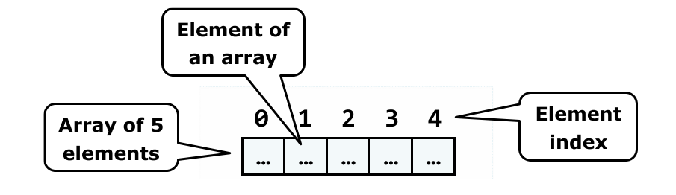
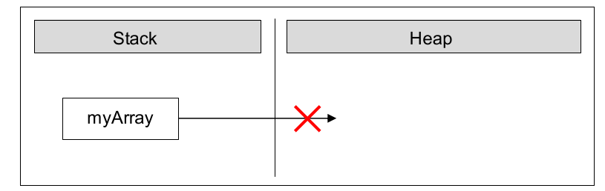
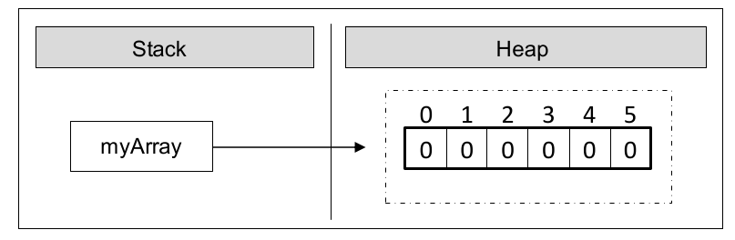
C# basics Arrays and Loops
Declaring an array
int[] array;
Memory allocation for array
int[] array = new int[6];
Notes:
Lesson 3 Arrays and Loops
Homework questions and answers
Introduction
Create a new branch

Slide 20
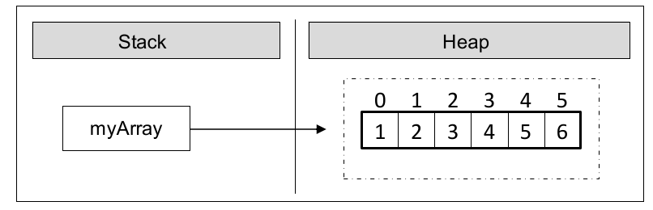
C# basics Arrays and Loops
Array initialization
int[] array = { 1, 2, 3, 4, 5, 6 };
Array length
int arrayLength = array.Length;
Length is not equal to the last element index!!!
Array access is by indeces
int firstArrayElement = array[0]; // 1
Going out of bounds of the array will cause an exception
System.IndexOutOfRangeException

Slide 21
C# basics Arrays and Loops
while(condition)
{
// loop body
}
for(int i = 0; i < condition; i++)
{
// loop body
}
do
{
// loop body
} while (condition);
foreach(var item in items)
{
// loop body
}
Notes:
Make a commit
Push the commit
Make a PR and approve it
End Lesson 3.

Slide 22
C# basics Methods

Slide 23
C# basics Methods
Method declaration
public string MethodName(int age, string name);
Method signature
MethodName(int age, string name)
Method implementation
<access_modifier> <return_type> <method_name>(<parameters_list>)
{
// … code goes here – in the method's body …
}
Method invocation
MethodName(25, “John”); MethodName(age, “John” + “Smith”);
Notes:
Lesson 4.
Homework questions and answers
Introduction
Create a new branch

Slide 24
C# basics Methods
Method with parameters
public static string MethodName(uint age, string name, string[] accounts);
Variable number of arguments
public static void PrintTotalSumForCategory(string category, params decimal[] prices)
Optional parameters
public static InputPassword(string login = “dummy”, string password = “dummy”);
Method overloading
public int GetSumOfIntegers(int a, int b);
public double GetSumOfDoulbles(double a, double b);
public int GetSum(int a, int b);
public double GetSum(double a, double b);
Notes:
Make a commit
Push the commit
Make a PR and approve it
End Lesson 4.

Slide 25
C# basics Enums and Strings

Slide 26
C# basics Enums
Directions direction = Directions.South;
enum Directions
{
South, // 0
East, // 1
North, // 2
West // 3
}
enum Directions
{
South = 2, // 2
East, // 3
North, // 4
West // 5
}
enum Directions
{
South = 2, // 2
East = 4, // 4
North = 5, // 5
West = 7 // 7
}
Notes:
Lesson 5 Enums and Strings.
Homework questions and answers
Introduction
Create a new branch

Slide 27
C# basics Strings
General representation
string name = “John Smith”;
Declaring and initializing
string company = “DataArt”;
Concatenation
string description = company + “ is IT company”; // DataArt is IT company
Interpolation
Console.WriteLine($“Company description: {description}”); // Company description: DataArt is IT company
General operations with strings
bool result = company.Contains(“Data”); // true
string companyUp = company.ToUpper(); // DATAART
string companyUp = company.ToLower(); // dataart
string rawString = “ DataArt ”;
string trimmedString = rawString.Trim();
J | o | h | n |  | S | m | i | t | h
Notes:
Make a commit
Push the commit
Make a PR and approve it
End Lesson 5.

Slide 28
C# basics Exception Handling

Slide 29
C# basics Exception Handling
try
{
}
catch
{
}
finally
{
}
try
{
}
catch (Exception_type)
{
// block of code
}
finally
{
}
try
{
}
catch (Exception_type variable_name)
{
// block of code
}
finally
{
}
Notes:
Lesson 6 Exception Handling
Homework questions and answers
Introduction
Create a new branch
Make a commit
Push the commit
Make a PR and approve it
End Lesson 6

Slide 30
C# basics Classes

Slide 31
C# basics Classes
public class Person
{
private string name; // field definition
public string Name // property declaration
{
get { return name; }
set { name = value; }
}
public Person() // parameterless constructor
{
name = “Incognito”;
}
// class body between two curly brackets
public Person(string name) // constructor with parameters
{
this.name = name;
}
public void GetIntroduction() // method declaration
{
Console.WriteLine($”My name is {name}”)
}
}
Notes:
Lesson 7 Exception Handling
Homework questions and answers
Introduction
Create a new branch

Slide 32
C# basics Classes
Person firstPerson = new Person(); // Create person without name
Person secondPerson = new Person(”Tom”); // Create person with name
// Persons’ introduction
firstPerson.GetIntroduction(); // My name is Incognito
secondPerson.GetIntroduction(); // My name is Tom
// Name first person
firstPerson.Name = ”Bob”;
firstPerson.GetIntroduction(); // My name is Bob

Slide 33
C# basics Classes
Generic Methods
public void Print<T>(T data);
string str = ”String to be printed”
Print<string>(str);
Generic Classes
public class Animal<T>
{
public T Species { get; set; }
public T Animal()
{
// Some code here
return T;
}
};
Notes:
Make a commit
Push the commit
Make a PR and approve it
End Lesson 7

Slide 34
C# basics Useful links
Svetlin Nakov and Team
“Fundamentals of Computer Programming with C#”
https://introprogramming.info/english-intro-csharp-book
Metanit site
https://metanit.com/sharp/tutorial/

Slide 35
Thank you!

